Slide 1
PERS-43
VFA Detailer Brief

Slide 2
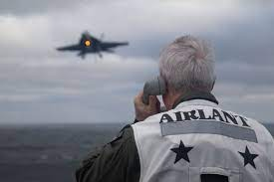
Agenda
PERS-43 Detailing Familiarization
Aviation Career Path
Selection Boards
Incentives
New Programs and Initiatives
Notes:
PERS-43
Review Mission and Organization
Health of the Force
Manpower Statistics (Today / Diversity / Inventory / Accessions)
Promotions (Control Grade / Merit Reorder)
Retention (Bonus / DH & PCC Behaviors)
Community Management
Career Path / Detailing
Selection Boards
Fleet Manning
Initiatives

Slide 3
Team VFA
Placement Officers
  VFA East/FDNF - LCDR Calvin “Da’gum” Stark
    calvin.a.stark.mil@us.navy.mil
  VFA West/F-35 - LCDR Kyle “LAB” Matson
    kyle.p.matson.mil@us.navy.mil
Assignment Officers
  VFA O-4 Assignments - CDR Adam “Roloff” Jackson
    adam.h.jackson4.mil@us.navy.mil
  VFA JO Assignments - LCDR Josh “Twerk” Elder
    darren.j.elder.mil@us.navy.mil
  Asst. O-6 Assignments - LCDR William “Lemur” Revell
    william.a.revell.mil@us.navy.mil

Slide 4
What Detailers actually do!
The detailer is your advocate!
  Orders, career timing, unique circumstances
  The more you tell us, the more we may be able to help
  Please communicate with us!

Slide 5
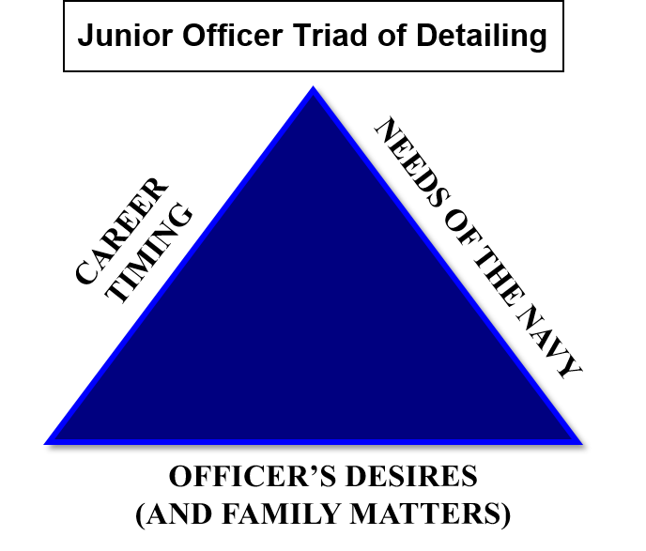
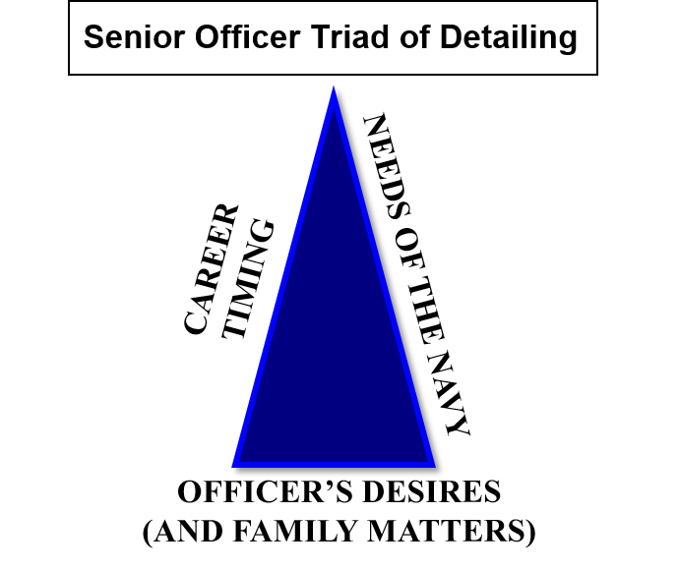
Detailing 101
5
Notes:
Detailing 101 – we use the two triangles to demonstrate the difficulty in balancing an aviator’s career. There is a significant difference in JO detailing and the Senior Officer detailing
The three sides of the JO triangle is more evenly balanced – career timing/needs of the navy/officer desires. However, the triangle is NEVER equilateral. As much as we try to mitigate the “needs of the Navy” demand, that is always the first priority. It is our job to minimize and balance that demand against your desires personally and professionally.
While the more senior you become your career timing and needs of the navy outweigh your desires – especially if you are due course, we will assign you by where the Navy needs you first, second by what rounds out your record to remain competitive, which is often aligned with needs of the navy and finally the member’s personal desires.
Here are the standard timelines for the detailing cycle. These are simple recommendations. Feel free to talk to your Detailer anytime.

Slide 6
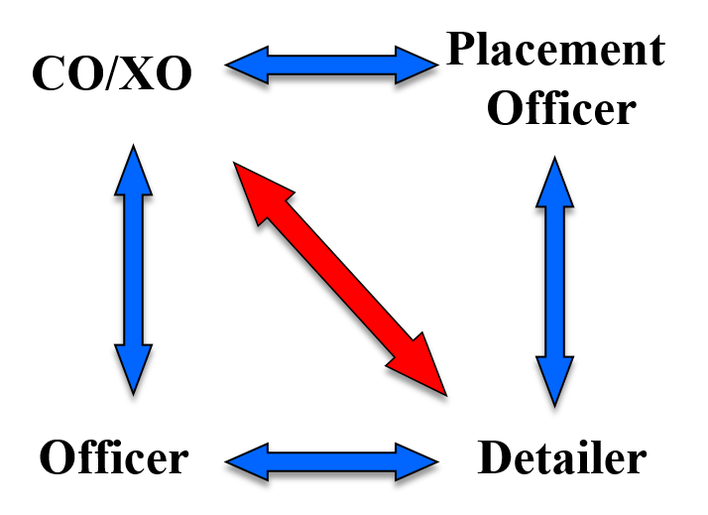
Detailing Process
JO Detailing / DH Detailing
  Community Slates
  Individual Orders
  CO inputs via Placement Officer
  Community Jobs
General Manager
Coach
Communication and Transparency Keys to Success
Player
Agent
Notes:
Everyone should be familiar with the Detailing graphic (arrows) and desired comm flow.
COs & XOs need to work through your placement officer, not through your officer’s detailer
1st Shore Tour: JO slates, except for VAW & VQ(T)
DH Detailing: Individual Orders, except for MPRF
CO Detailing: Individual Orders, except for MPRF
ISICs/CAGs

Slide 7
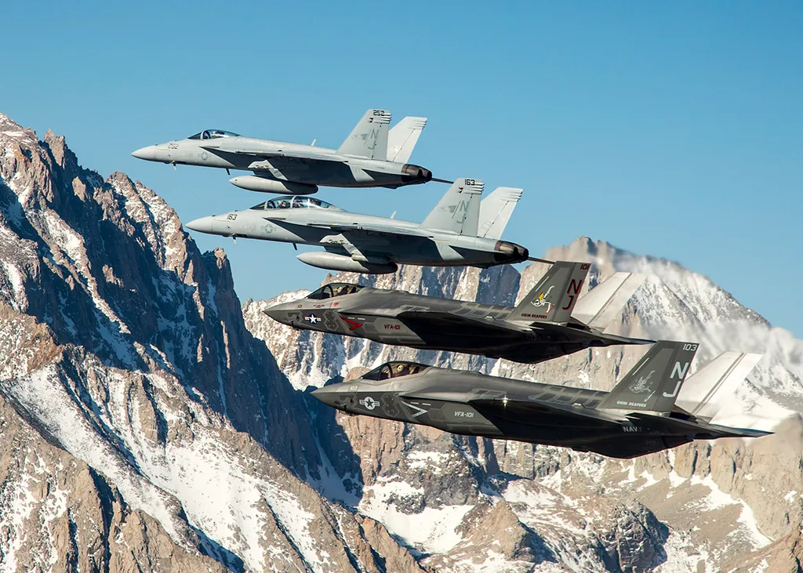

Notes:
Any questions about our agenda, 43’s mission, or structure?

Slide 8
Aviation Career Paths
Warfare Area Focus
13XX ACQUISITION PATH
2nd ACQ SHORE
ACQ SHORE
MAJ PROG CMD / MASC
TPS /
1st ACQ SHORE
FRS
DH
2nd
SHORE
FRS
XO/CO
SHORE/ SEA
MAJ CMD
DC/
Pax/
Major
Staff
FLT
TRNG
FRS
1st SEA
1st SHORE
2nd SEA
SHORE/ SEA
SHORE
SEA/OVER-SEAS
SHORE/ SEA
SHORE/SEA
13XX FLEET PATH
PFI PATH
PRODUCTION FLYING
PRODUCTION FLYING/STAFF
PRODUCTION FLYING/STAFF
PRODUCTION FLYING/STAFF
PRODUCTION FLYING/STAFF
PRODUCTION FLYING/STAFF
DH SBs
CDR CMD SBs
MAJ CMD SBs
O4 SB
O5 SB
O6 SB
0 2 4 6 8 10 12 14 16 18 20 22 24 26 28
Acft/Tactical
Quals
Production
Flag Aide
USNA/NROTC
Staff
PEP
CAG Staff
Ship
SJO
Afloat Staff
Staff
Grad Ed/JPME
Joint Staff
Grad Ed/
JPME
Staff
CVN Staff
Afloat Staff
DC
Staff
Nom
DC/Joint Staff
Grad Ed/
Fellowship
Afloat Staff
Staff
TPS
VX / HX
UX Tour
Joint/
Acquisition
OPNAV
NAVAIR
NAWC
VX/OPTEV
NAVAIR
NAWC
Joint/ACQ
OPNAV
VX/OPTEV
Staff/J8/N8
ONR

Slide 9





Aviation Career Continuum
Warfare Area Focus
Leadership / Operational Area Focus
COMMAND
PCC TOUR
O5 SEA
O5 SHORE
SECOND
SHORE
Combat
Leader
Aviation
Expertise
NAE
Impact
Continued
Broadening
DH
Broadening
Assignment
SECOND SEA
Advanced
Warfighting
NAE Leader
& Practitioner
DH
Skill
Building
Joint
Major Staff
Grad Ed/JPME
Acquisition
Operational
OP-T
Special
Mission
CVN Staff
Afloat Staff
DC/Joint
Grad Ed
Afloat Staff
HOD
Major Staff
Acquisition
FIRST SHORE
FIRST SEA
NAE Production
Driver
Advanced Skills
WTI
SJO
Ship
Afloat Staff
Aide
Operational
OP-T
Initial Warfare
Qualification
Operational
Foundation
Tactical
Excellence
FRS / WTI / NAWDC
VT / HT
TPS / VX / HX
Shore Staff
FLT TRNG
PFI PATH
Fundamentals
O4 SEA/SHORE
DH SBs
CDR CMD SBs
O4 SB
O5 SB
0 2 4 6 8 10 12 14 16 18 20

Slide 10
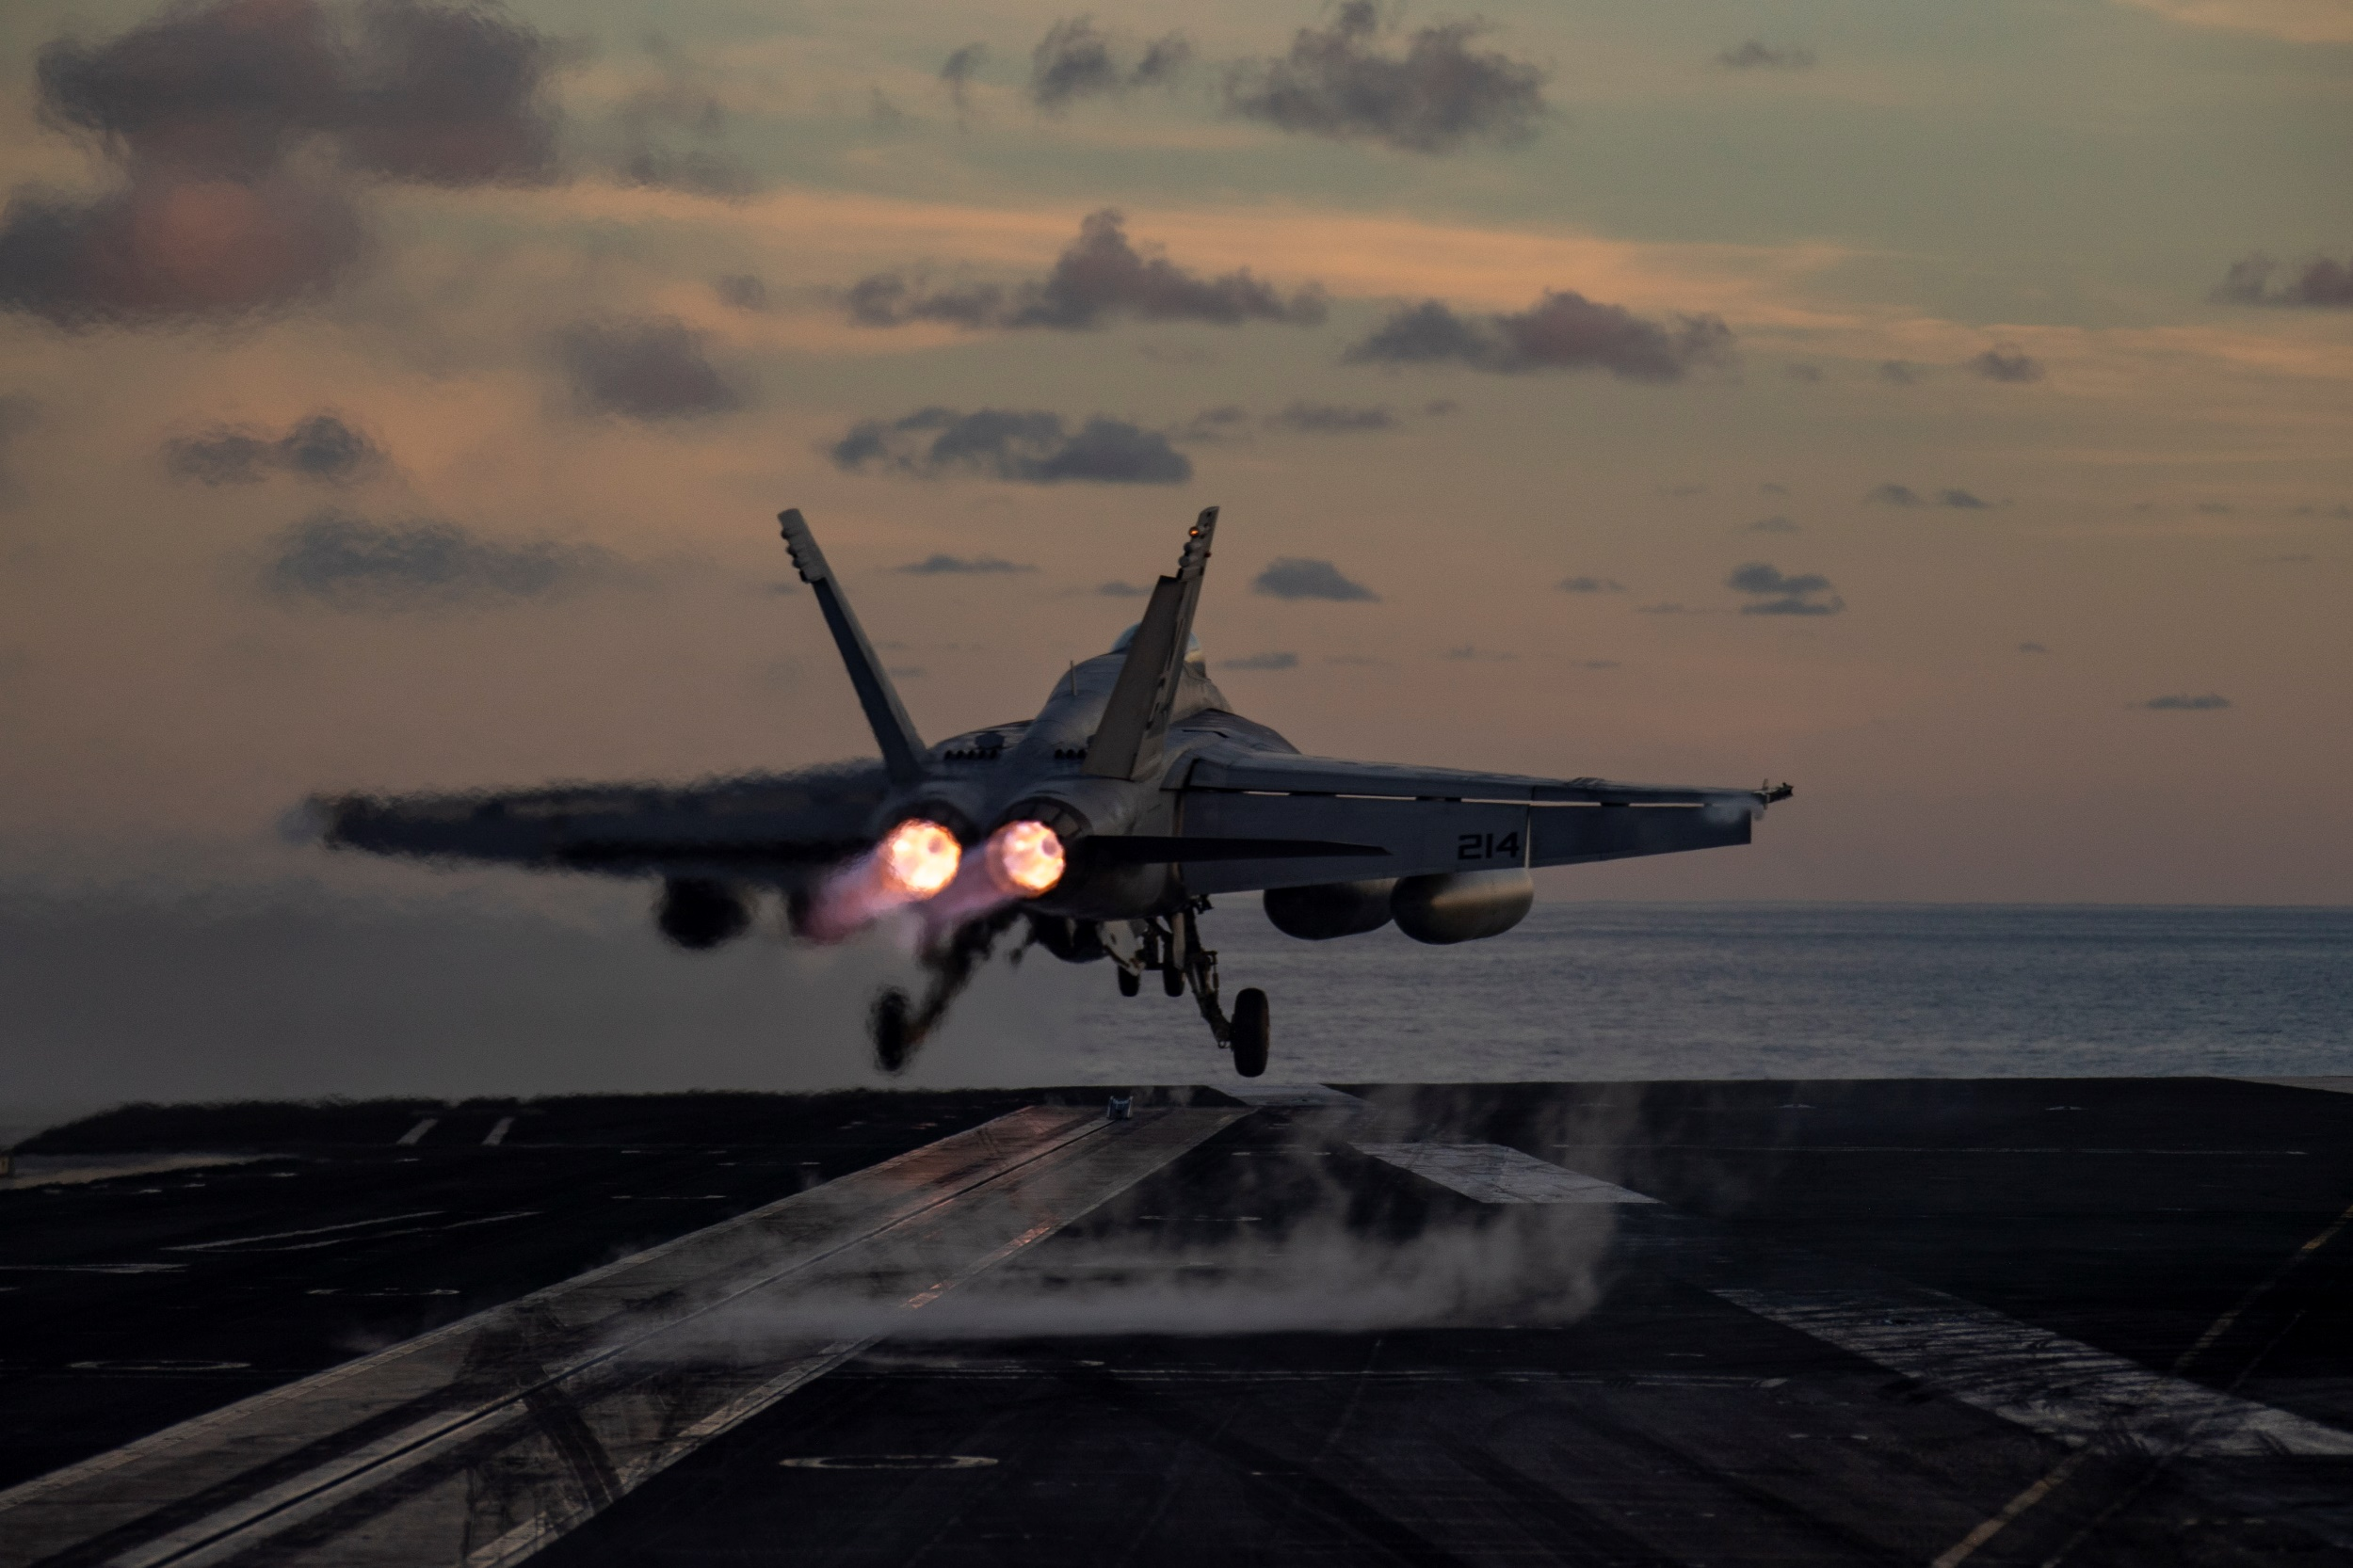

Slide 11
JO Slate Process
The process
  Three slates per year (Aug, Dec, Apr)
    Aug (Dec – Mar PRD)
    Dec (Apr – Jul PRD)
    Apr (Aug – Nov PRD)
  Records ranked
  CO inputs / officer preferences / demand signal
Billet availability
Slate results are final
  SFTI / TPS application

Slide 12
First Shore Options
Production billets are the priority
1310 / 1320
  SFTI: TOPGUN / STRIKE / WEPS SCHOOL / VX-9 / FRS
  TPS (Developmental Test): USN / USAF / Foreign
  FRS: VFA-106 / 122 / 125
  VT: Kingsville / Meridian / Pensacola
  VX-9 (Operational Test)
  NAWDC
  VFC-12 / 13 / 111

Slide 13
First Shore Options
Non - production options are needs of the Navy and VFA Community
  PEP
  Flag Aide
  CNAL / CNAP Staff
  Wing Staff

Slide 14
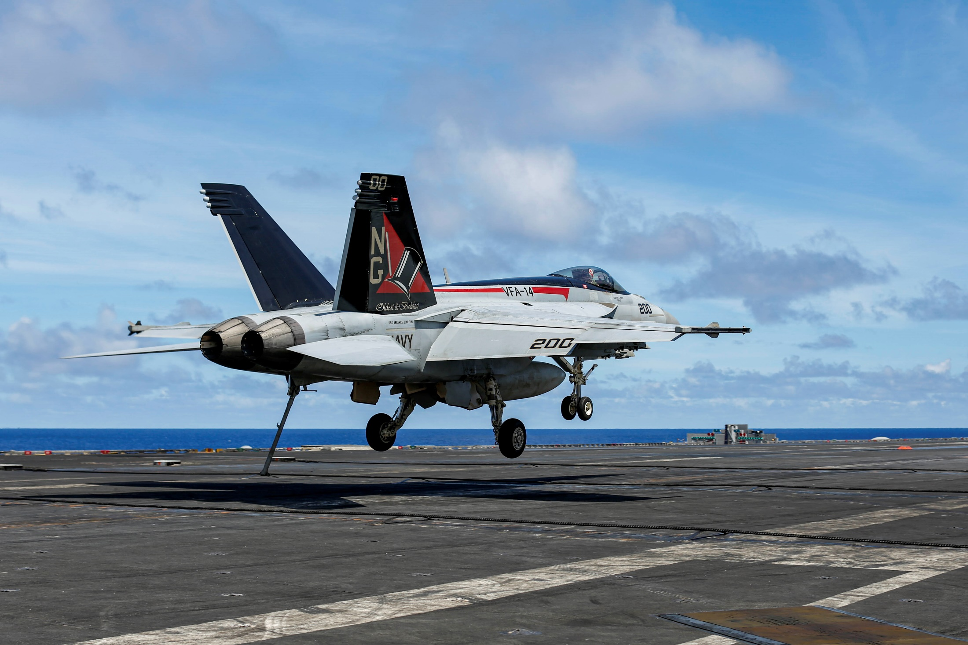


Slide 15
Second Sea Tour
Will everyone do a second sea tour?
  It depends!

Slide 16
Second Sea Tour
Depends on retainability / GREMAIN status
  Retainability
    Minimum 24 months at shore tour
    12 month till MSR
  GREMAIN / OBLISERVE
  SFTI / TPS
    24 months sea tour / 4 years post TPS
  Education
    Depends on program
  CAT Other refresh (minus CQ only) = 24 month OBLISERVE

Slide 17
Second Sea Tour
Standard Second Sea Tours
  Training Officer
  CVW Staff
  Squadron “Super JO”
  CSG Staff
  Nominative positions (Flag Aide)
  Numbered Fleet Staff
  NSW Fires Officer (1320)
  GSA (Global Support Activity)

Slide 18
Resignations
All Obligations must be met
  MSR complete (Title 10 winging obligation)
  GREMAIN (ROTC, EMBA, GEV, TA, GI Bill)
  MTS (Minimum Tour for Separation)
    See MILSPERMAN 1301-108
    24 months for PCS move on shore duty unless OCONUS PCS (12 months)
    12 months for all CONUS PCS Sea Duty moves
  Resignation withdrawal / modification

Slide 19
Lateral Transfer
Eligibility
  1 year from MSR
  Boards twice annually IAW MPM 1212-010 and OPNAVINST 1210.5 (Feb & Aug)
  NAVADMIN released prior to each board
  ***Losing community must agree to loss***

Slide 20
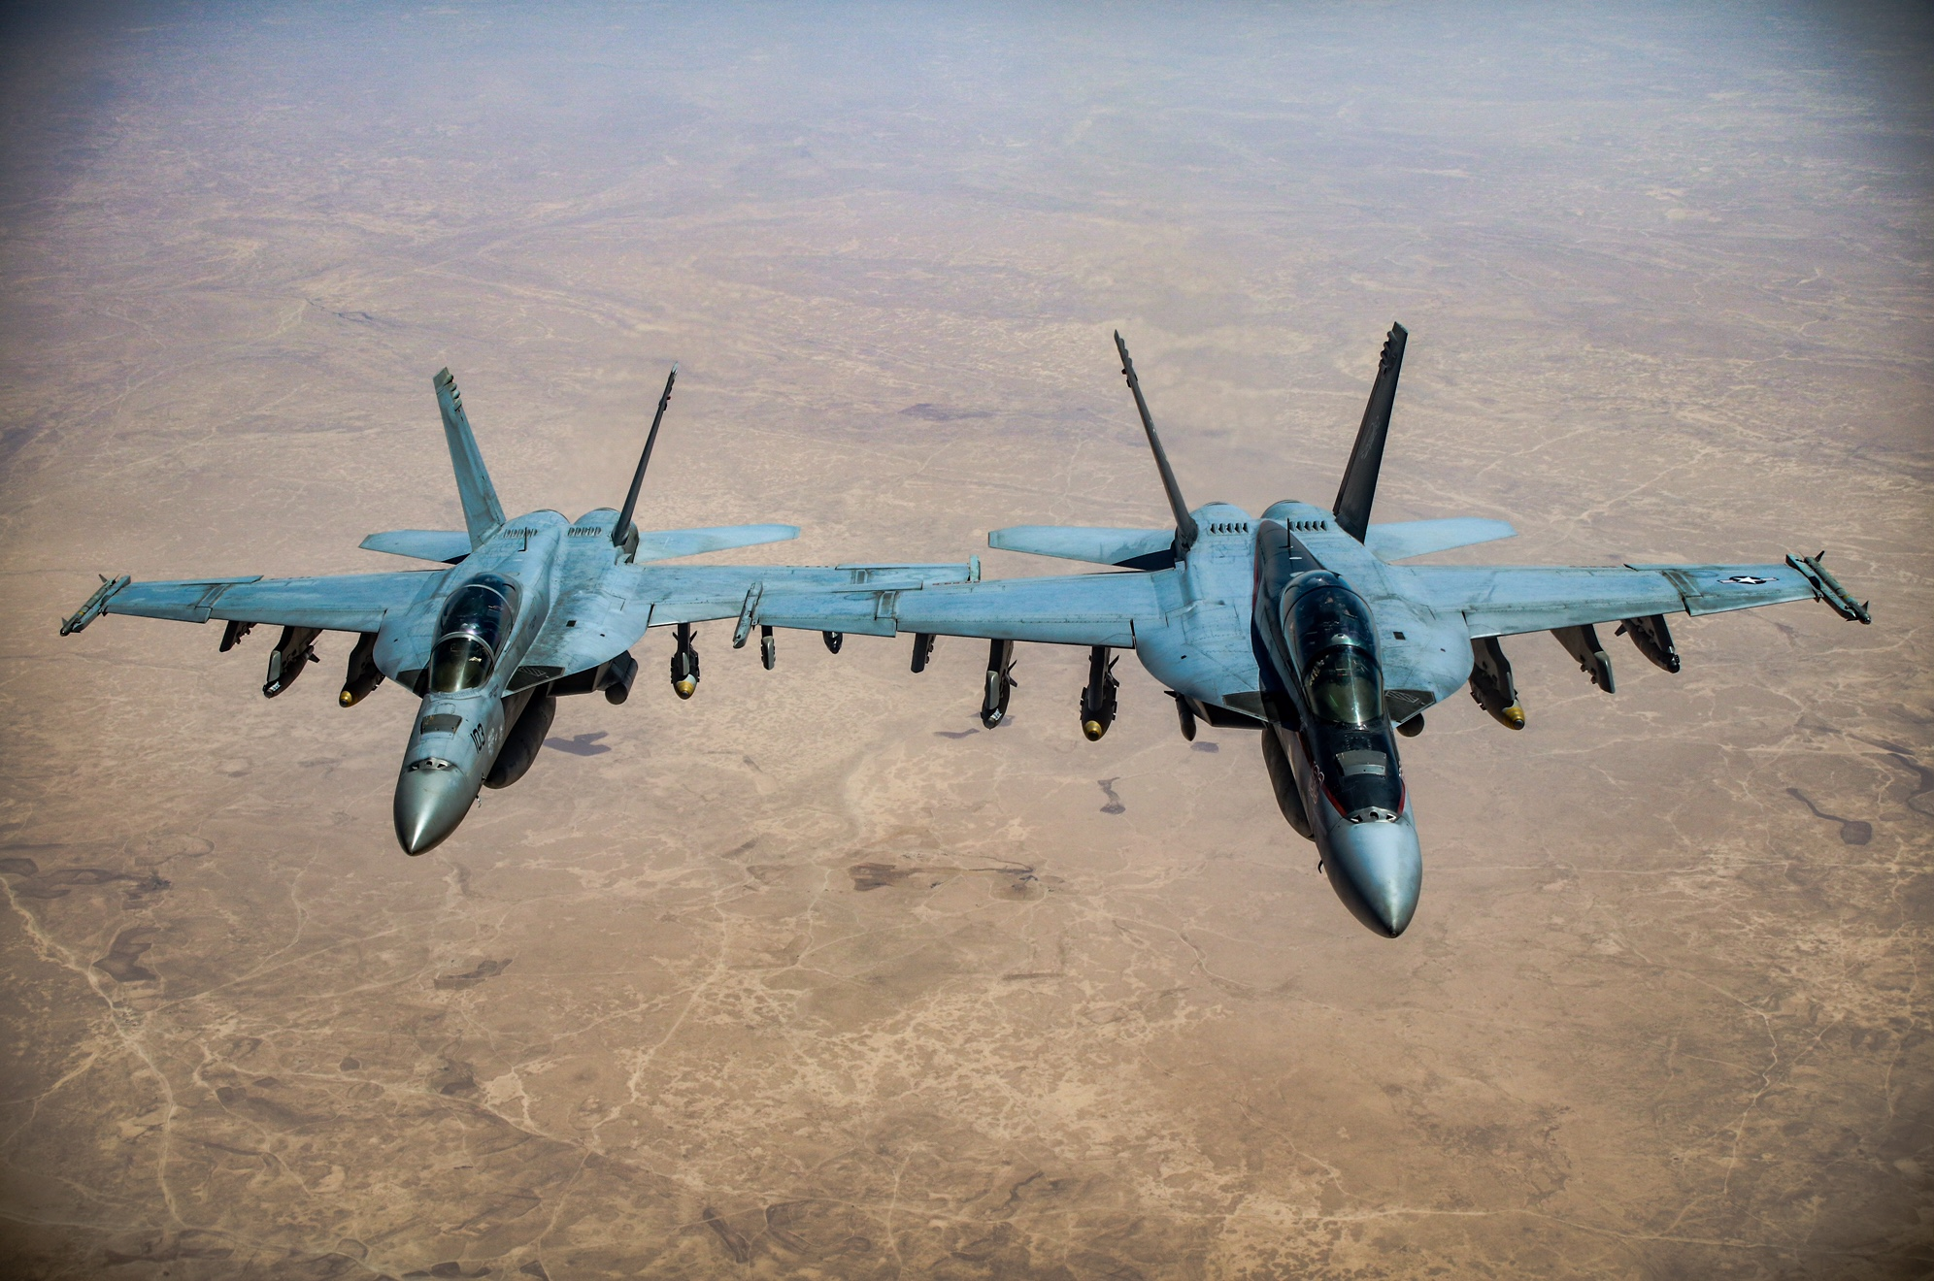

Slide 21
Aviation DH Tour
27-33 months
Most important tour for future admin / statutory milestones
Promotion Considerations
  Competitive EP = O5
  Non competitive MP or P likely a terminal O4
Command aspirations
  Competitive #1 EP as OPSO / MO

Slide 22
DH Selection and Slating
VFA opportunity rates
In zone and above zone looks
Operational Training DH (OP-T)
DH Slate Process
UNCLASSIFIED

Slide 23
Post DH Tour
Balance career needs / desires / performance
Options
  JPME 1: War College
  Joint Tour: JCS / COCOM / NATO
  Flying: FRS / NAWDC / VX / VT
  Major Staff: OPNAV / CNAL/P / NPC / Fleet
  Other: Aide / OLA
“Community Valued” or “Community Jobs”
  PERS / CNAL MAP Writer / CNAP Readiness / FRS TO / NAWDC CVW TO

Slide 24
Post DH Detailing
PERS-43 Goal:
  Keep options open by remaining competitive
DH performance determines options
  #1 EP:
    Community Billets
    Joint Duty Assignment (JCS / COCOMs)
    Graduate Education / Service College
    FRS
  #2 EP:
    Major Staffs / PFI / CNATRA / OPNAV

Slide 25
Advancement
Sustained Superior Performance
  EP in first sea / shore tour
Advanced Qualifications
You own your record
  AQDs, Awards , FITREPs submitted
Graduate Education (YG15 and later)
  Future requirement will drive a change to standard career path

Slide 26
Education Opportunities
War College
  In residence / Distance Learning
Foreign War College
Naval Postgraduate School
Olmstead Scholarship
Fellowships / Federal Exec. Fellowship
Pol-Mil Masters Program
Graduate Education Voucher (GEV)
Tuition Assistance (TA)
Low Residency Graduate Education Program (LGEP)
Fleet Scholar Education Program (FSEP)

Slide 27
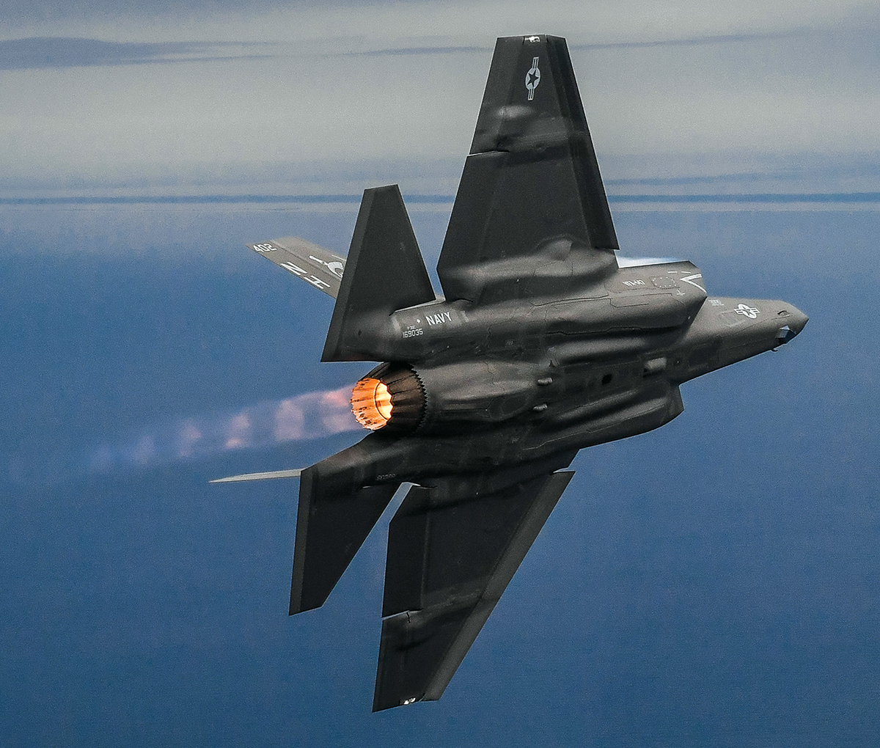

Slide 28
Selection Boards
Statutory Boards
  Promotions to next Rank
  Board Members from every community
  You are responsible for your record
Administrative Boards
  Selection process for career milestones
  Department Head, Command, Major Command
    Bonus and AV(N) coincide with AMCSB
  Membership limited to aviation communities
Select the best and most fully qualified!
Notes:
There are 2 types of Boards: Statutory Boards and Admin Boards
Pers-43 has nothing to do with Stat or promotion boards
Stat boards are made up of every community – so a Sub officer could be briefing your record for promotion
There is no courtesy look from Pers-43 at your record for promotion boards – so make sure your record is up-to date and good to go
Admin boards – Pers-43 facilitates all DH/Command/Major boards: what that means is Per-43 does all of the eligibility checks for these boards, we scrub all of your records to ensure nothing is missing (you should help by looking at your individual record prior to any board).
You may find this odd but there is still confusion on this out there. Yes I have had to inform sitting CO’s and XO’s. That’s not a dig, merely a point to make that if you have questions about these processes, ASK NOW. You are going to be mentoring JO’s and DH’s constantly, you need to make sure you are giving them good guidance.
Welcome to the Company.

Slide 29
Statutory Boards
Governed by Title 10, US Code
  LTs are given two opportunities to select for LCDR
    If 2xFOS (Failure of Selection) for O4, you will be separated 7 mos and a day later.
    Prior enlisted at 18 YOS have sanctuary
  LCDRs that fail to select for CDR are retained until statutory retirement
  Membership consists of all URL and all eligible officers are evaluated together

Slide 30
ADHSB
Eligibility determined by convening order
  O4 Board May 2024
  1st Look DH May 2025
  2nd Look DH May 2026
  NLT DH Oct 2026
Zone Shifts
  Annual scrub of total personnel at rank
  Message released every December

Slide 31
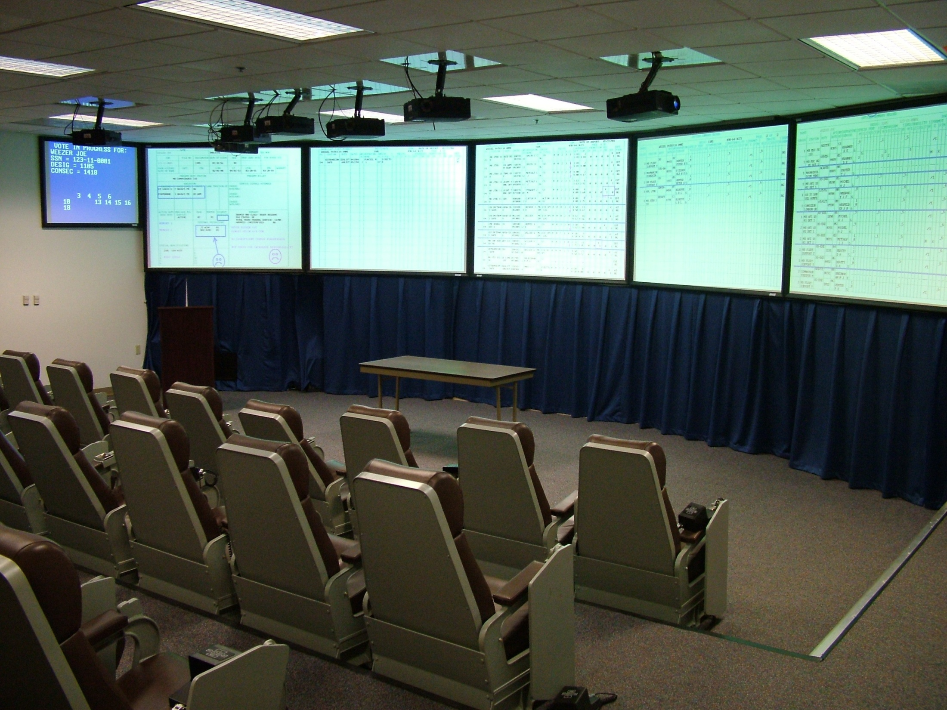
UNCLASSIFIED

Slide 32
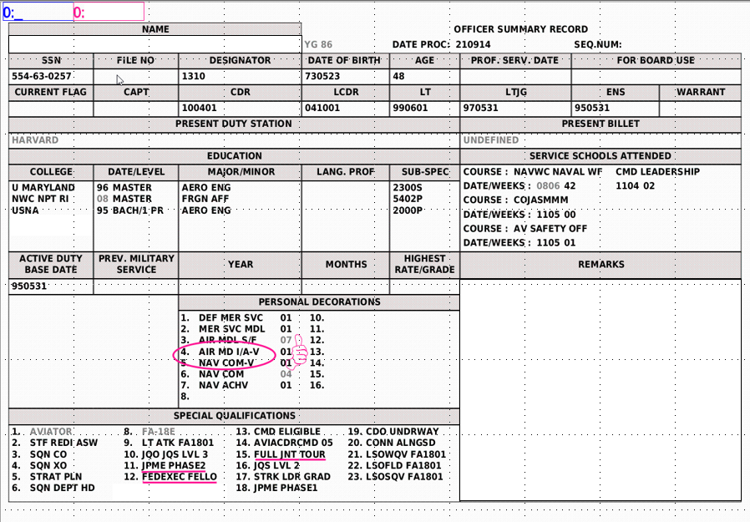
Sample OSR Mark-Up

Slide 33
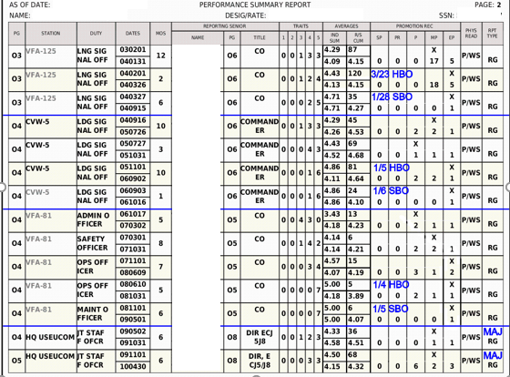
Standardized Mark-Up

Slide 34
The “Scattergram”
# PCT / # CUM
100
97
94
93
91
87
83
80
77
74
71
3
3
2
3
2
3
5
6
3
6
8
11
13
16
21
27
100
97
94
93
91
87
83
80
77
74
71
PCT (Confidence Score)
Notes:
After all the records are briefed the Scattergram is posted
For this example there where 27 records briefed
Reference the the top on the left side that is confidence score (in percentage)
3 records with a confidence score of 100 for a total of 3 records
3 records with a confidence score of 97 for a total of 6 records
Then as you go all the way down to the RED section there is usually a clear break.
For the purpose of our discussion we’ll simplify the process a little. Recognize that there is more scrutiny to determine clear breaks. If there aren’t clear breaks, the members re-brief/vote and start crunching records.
In this case, we have two very simple breaks that help demonstrate the scattergram utility.
First there is a clean break at a confidence score of 80 and below and a clean break with a confidence score of 94 and above
(NEXT SLIDE)

Slide 35
The “Scattergram”
# PCT / # CUM
Tentatively
Select
100
97
94
93
91
87
83
80
77
74
71
3
3
2
3
2
3
5
6
3
6
8
11
13
16
21
27
100
97
94
93
91
87
83
80
77
74
71
“Crunch”
8 records
to select 4
Remove From
Consideration
PCT (Confidence Score)
Notes:
A member will motion to remove those records with 80 and below from consideration and to tentatively select all records with a confidence score of 94 and above.
After the motion is seconded and voted to approve, this leaves the board with 8 records to “Crunch” – and these record will all be briefed and scored again until the desired number of selects is met

Slide 36
Board Takeaways
Maintain Your Rec
  OSR/ODC/PSR
  FITREP / Qualifications / Awards
    Missing noticed by members
    Detach FITREPs eliminate HW FITREP ambiguity
Electronic Submission of Selection Board Documents (ESSBD)
  BOL Electronic submission NLT 10 working days prior
  PERS-8 facilitates STAT boards
    PERS-43 cannot help
  Your Participation at both Admin and Statutory Boards is essential!
Notes:
FY-20 O4 – 575 selects, foundation for FY-21 DH board
FY-21 O5 – 229 selects, foundation for FY-21 Command board
FY-20 O6 – 99 selects, foundation for FY-21 AMCSB
SWO/SUB ~ 5yr averages
Major Command
SWO: 31.6%
SUB: 50.3%
CDR Command
SWO: 33.3%
SUB: 25.6%
DH
SWO: 75.6%
SUB: 67.2%

Slide 37
Officer Records
Record maintenance is an individual responsibility
  Board Assistant Recorder reviews are a courtesy
Most common problems with records:
  Missing/gapped/rejected FITREPs
  Missing awards, qualifications, and advanced education
Incomplete record may highlight lack of attention to detail
Board correspondence is not a permanent record fix
It’s your record. Keep it updated!
Notes:
37
Attention to detail – own your record and ensure its squared away and not missing any information
Great topic for JO mentorship is how to check their records

Slide 38
ACSB Deferrals
ACSB Exception to Policy “deferral” option
Officers disadvantaged by zone shift after DH slate
ACSB Deferral ≠ Promotion Deferral
  Officers with a qualifying tour that has affected career timing can request to Opt-out of a promotion board (NAVADMIN 154/21)
  Primarily graduate education or fellowship
Notes:
TAILHOOK / Fleet engagement version
Advertised with detailed notes sent to all eligible officers
PERS-43 reviewed and provided recommendations to Board President prior to convening the ACSB.
ETP deferral requests were generally intended for officers who were disadvantaged due to zone creep between DH slate release and 30th month of DH tour.
47 Deferral requests were approved for IZ officers.
17 Requests for Additional Consideration were approved for AZ officers (follow on to the OP Only ETP from FY-20 ACSB).
A deferral should not be used by leadership as a way to keep an officer past the point where they should have “normally” received a high water breakout FITREP.
All deferral requests will be reviewed and approved on a case by case basis
Additional Look
FY-21 “Additional Consideration” ETP’s as a result of the FY-20 “Op-Only” ETP received their final AZ look at command
Officers with approved FY-20 ACSB OP Only requests, that were not selected for OP Command, were required to request an additional look for the FY-21 ACSB.

Slide 39
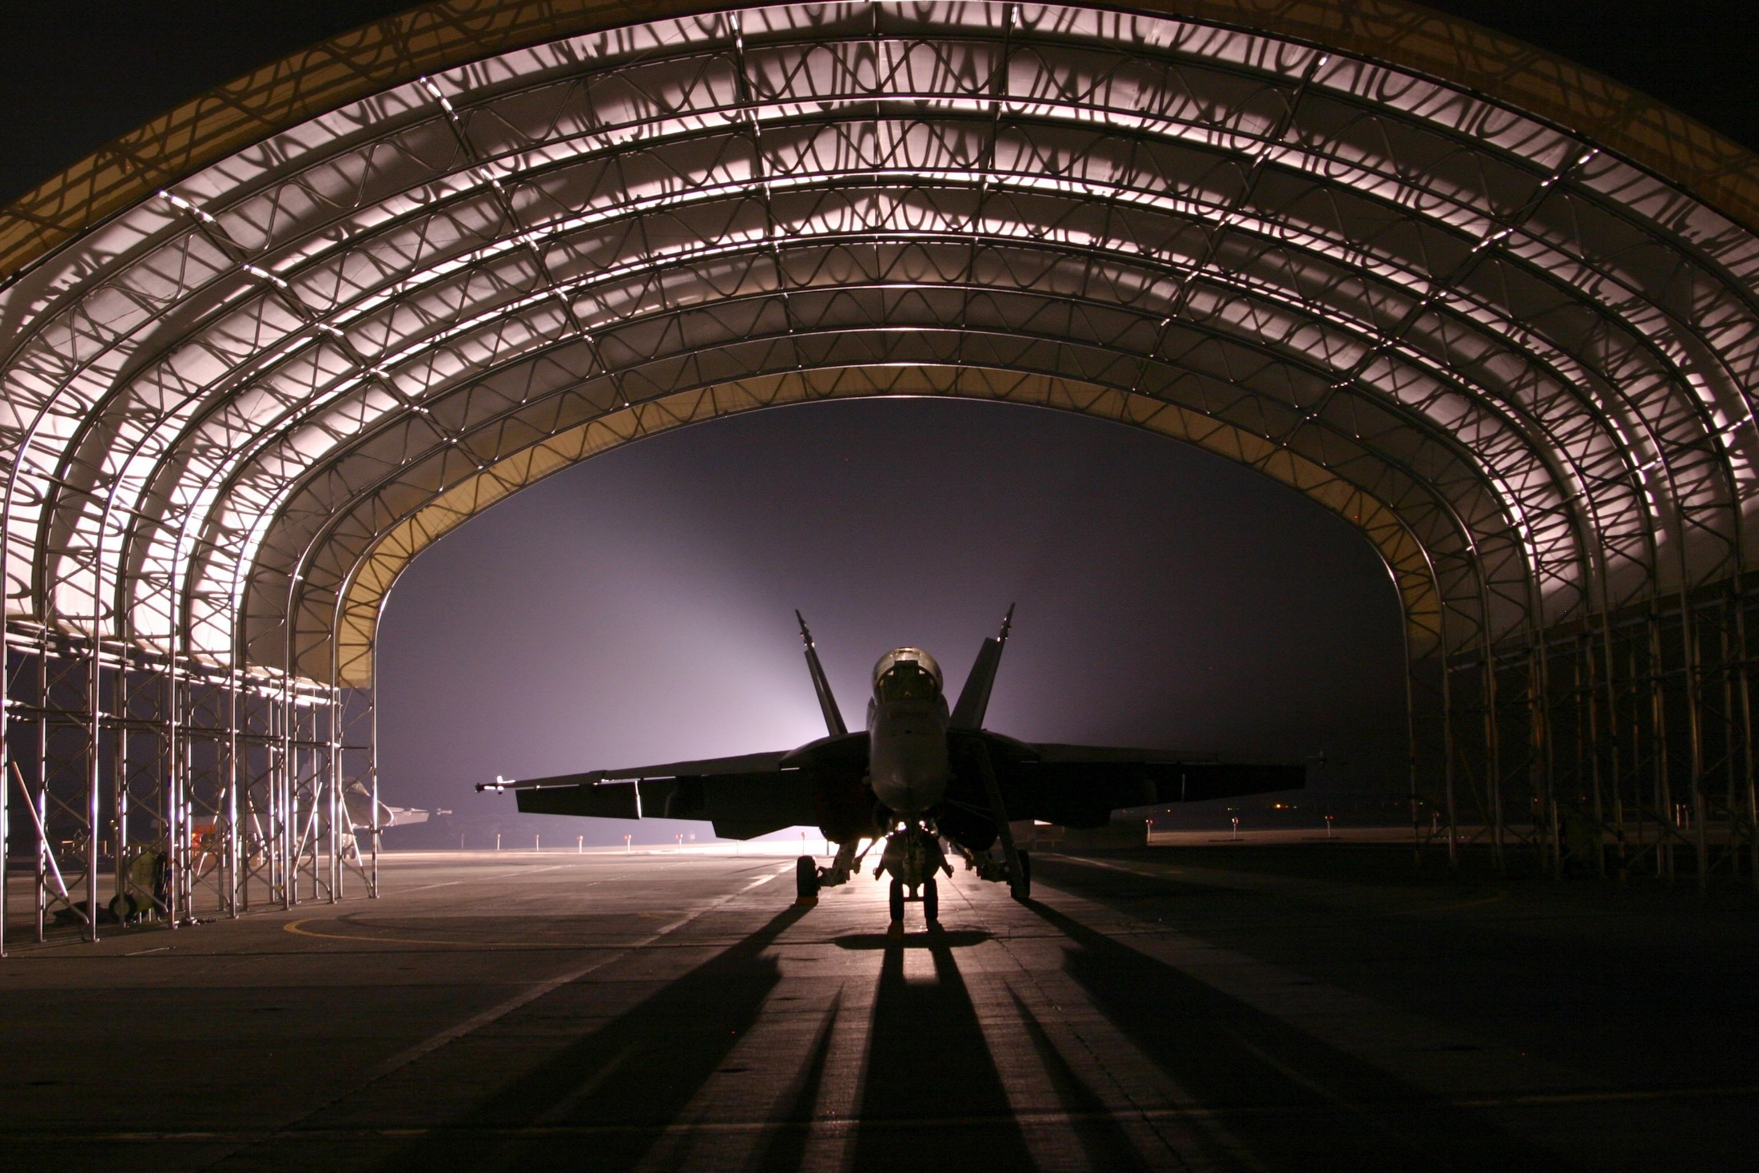

Slide 40
AvIP/AvB
(NAVADMIN 049/21)
Aviation Incentive Pay (AvIP)—Flight Pay
Legacy Flight Pay
  Rigid scale tied to Years of AVN Service (YAS)
  Max of $850/month at 14 YAS
  Not merit based—all paid same rates
Aviation Incentive Pay Today
  Pay levels by YAS discretionary
  Max up to $1,000/month at >10 YAS
  Merit based — Paid more for serving in screened milestone assignment
Aviation Bonus (AvB)
Legacy Dept Head Bonus
  One option (5 year contract)
  Eligibility linked to MSR
  No incentives for early/longer commitment
DH Bonus Today
  Flexible options (3, 5, and 7 year contracts)
  Eligibility linked to O-4 selection
  Incentivized for earlier/longer commitments
Legacy PCC Bonus
  Later commitment, not linked to PCC retention
  Value not competitive with civilian hiring options
PCC Bonus Today
  Requires earlier commitment, improved retention
  Total value increased to compete for talent
Merit-based, measured approach to retain our top talent
Notes:
AvIP and AVB ($$$) one ever to influence retention.
FLIGHT PAY
More $$$ for serving in milestone screened assignment
DH BONUS
Old Tied to MSR… leading to community timing differences and sunk costs
New
Tied to O-4 selection
Incentivies early commitment ($5K more per year)
Or, allows flexibility 3yr and 5 yr options
Annual rate based on T/M/S & Designator Selectivity
COMMAND BONUS
Old $36K
New $100K (eligible when a PXO)
ADHRB NAVADMIN 049/21
The AC ADHRB eligibility criterion includes selection for lieutenant
commander (LCDR) and the FY-21 ADHRB is intended for officers selected for
promotion to LCDR in the FY-21 LCDR statutory board. These officers will be
considered for department head in the FY-22 Aviation Department Head Screen
Board (ADHSB) scheduled to convene in the spring of 2021. Additionally,
eligible officers must have an Active Duty service obligation (ADSO)
associated with undergraduate flight training ending in FY-19 or
later.
Contracts are offered with either a three or five-year obligation
that begins upon expiration of the officers winging ADSO or contract
approval, whichever is later. The intent is to provide flexibility when
making career decisions and to encourage officers to fulfill a department
head tour and continue naval service.
The Navy values an early commitment and a five-year obligation. An
officer who submits a five-year contract prior to the ADHSB results being
published will receive the maximum annual rate specific to their
type/model/series and designator (T/M/S+D).
If an officer prefers a three-year contract or wishes to wait until the ADHSB
selection results are public, the ADHRB annual amount reduces by $5,000 per
year.
AC ADHRB retention bonus pay rates for FY-21 include:
Five-year obligation, early rate:
HM Pilot $35,000/year ($175,000 total)
HSC Pilot $35,000/year ($175,000 total)
HSM Pilot $25,000/year ($125,000 total)
VAQ Pilot $35,000/year ($175,000 total)
VAQ NFO $25,000/year ($125,000 total)
VAW Pilot $25,000/year ($125,000 total)
VAW NFO $15,000/year ($75,000 total)
VRC/VRM Pilot $35,000/year ($175,000 total)
VFA Pilot $35,000/year ($175,000 total)
VFA NFO $15,000/year ($75,000 total)
VP/VQ(P) Pilot $35,000/year ($175,000 total)
VP/VQ(P) NFO $10,000/year ($50,000 total)
VQ(T) Pilot $25,000/year ($125,000 total)
VQ(T) NFO $15,000/year ($75,000 total)
Five-year obligation, standard rate:
HM Pilot $30,000/year ($150,000 total)
HSC Pilot $30,000/year ($150,000 total)
HSM Pilot $20,000/year ($100,000 total)
VAQ Pilot $30,000/year ($150,000 total)
VAQ NFO $20,000/year ($100,000 total)
VAW Pilot $20,000/year ($100,000 total)
VAW NFO $10,000/year ($50,000 total)
VRC/VRM Pilot $30,000/year ($150,000 total)
VFA Pilot $30,000/year ($150,000 total)
VFA NFO $10,000/year ($50,000 total)
VP/VQ(P) Pilot $30,000/year ($150,000 total)
VP/VQ(P) NFO $5,000/year ($25,000 total)
VQ(T) Pilot $20,000/year ($100,000 total)
VQ(T) NFO $10,000/year ($50,000 total)
Three-year obligation:
HM Pilot $30,000/year ($90,000 total)
HSC Pilot $30,000/year ($90,000 total)
HSM Pilot $20,000/year ($60,000 total)
VAQ Pilot $30,000/year ($90,000 total)
VAQ NFO $20,000/year ($60,000 total)
VAW Pilot $20,000/year ($60,000 total)
VAW NFO $10,000/year ($30,000 total)
VRC/VRM Pilot $30,000/year ($90,000 total)
VFA Pilot $30,000/year ($90,000 total)
VFA NFO $10,000/year ($30,000 total)
VP/VQ(P) Pilot $30,000/year ($90,000 total)
VP/VQ(P) NFO $5,000/year ($15,000 total)
VQ(T) Pilot $20,000/year ($60,000 total)
VQ(T) NFO $10,000/year ($30,000 total)

Slide 41
Monthly Flight Pay
Aviation Incentive Pay (AvIP)—Flight Pay
Baseline Flight Pay
  YAS Monthly Rate
  <2 $125
  >2 $156
  >3 $188
  >4 $206
  >6 $650
  >14 $840
  >22 $585
  >23 $495
  >24 $385
  >25 $250
Payments on the milestone rate start with DH selection
Milestone Flight Pay
  YAS Monthly Rate
  <2 $125
  >2 $156
  >3 $188
  >4 $206
  >6 $650
  >10 $1000
  >22 $700
  >24 $450
Return to Baseline Flight Pay after 2xFOS for Milestone (ACSB)

Slide 42
Department Head Bonus
  Flexible options (both 3- and 5-yr contracts)
  Eligibility linked to O-4 selection
  Incentivize for earlier/longer commitments (+$5,000/yr)
    Early rate can be taken from bonus message release until ADHSB
    After ADHSB, 3-yr contract available
    Must take bonus by Aug 31 following ADHSB
  Rates may change from year to year
Merit-based, measured approach to retain our top talent

Slide 43
Detailer Information
CDR Adam “Roloff” Jackson
  VFA O-4 Detailer
    adam.h.jackson4.mil@us.navy.mil
LCDR Josh “Twerk” Elder
  VFA JO Detailer
    darren.j.elder.mil@us.navy.mil

Slide 44
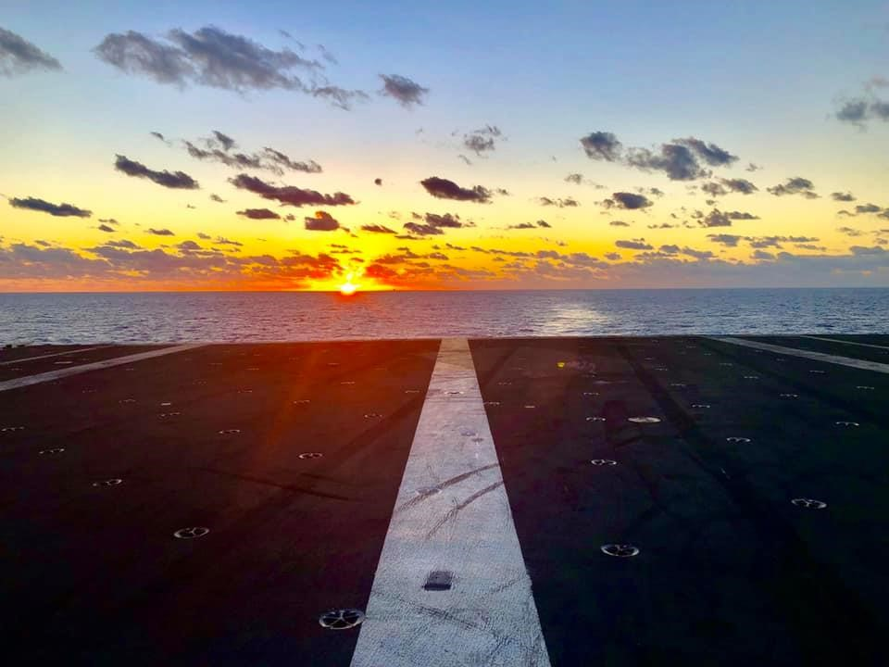

Questions?

